Slide 1

FloBot
Team 4
Presented By :
Kardelen Yagiz | psyky4 | 20549483
Jing Xu | smyjx3 | 20514985
Jamie Holt | psyjh29 | 20560017
Notes:
Kardelen
Hi everyone, we are Group 4 and our project is FloBot – a robotic assistant that helps users manage their menstrual health more comfortably and conveniently. We'll walk you through the idea, how we built it, and show a video demo in action.

Slide 2
The Problem
Support during menstruation
During menstruation, many users experience fatigue, discomfort and pain
Limited mobility can make routine tasks harder
Emotional and physical symptoms fluctuate during the cycle
There are gaps in personalised care and reminders
Notes:
Kardelen
A lot of people struggle with tiredness, discomfort, and mood changes during their period. Everyday tasks can feel harder, and logging how you feel through apps usually takes too many steps. We wanted to make that easier, something you can interact with quickly, without needing to open your phone every time.

Slide 3
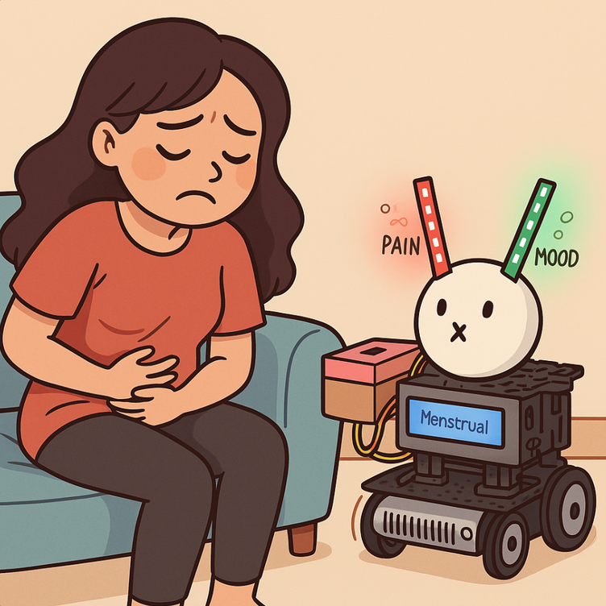
Overview of Our Solution
LED bars used to display the pain and mood tracking
platform where the user can load up items e.g. painkillers, pads etc
buttons to input pain and mood levels, and also track menstruation beginning and end
display screen that shows the user which part of their cycle they’re on (i.e. menstrual, ovulation etc)
Notes:
Kardelen
FloBot is our answer. It lets users press simple buttons to log how they’re feeling — pain, mood, and when their period starts or ends. The robot then gives visual feedback using LED lights, shows which part of the cycle they’re on, and even carries supplies like painkillers or pads.

Slide 4
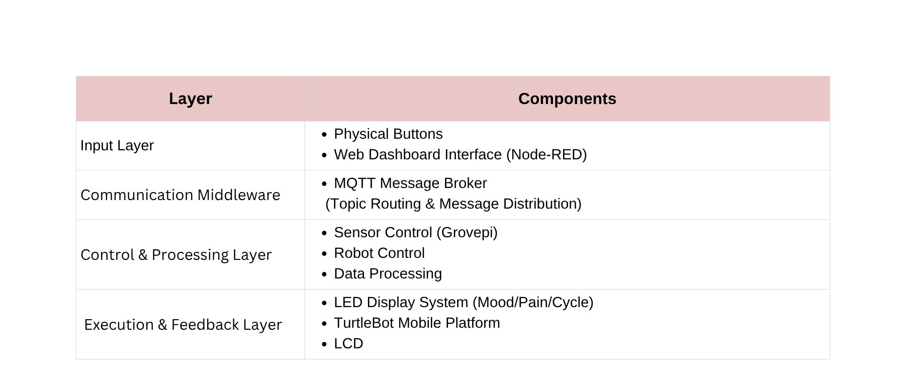
System Architecture
Notes:
Jing
Our system has four layers.
The input layer includes buttons and LEDs.
The middle layer handles data transfer using MQTT.
The processing layer is where data is stored and handled.
And the feedback layer includes the lights, screen, and the robot itself.

Slide 5
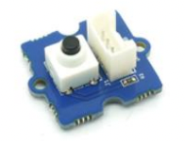
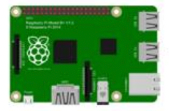

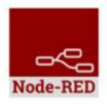
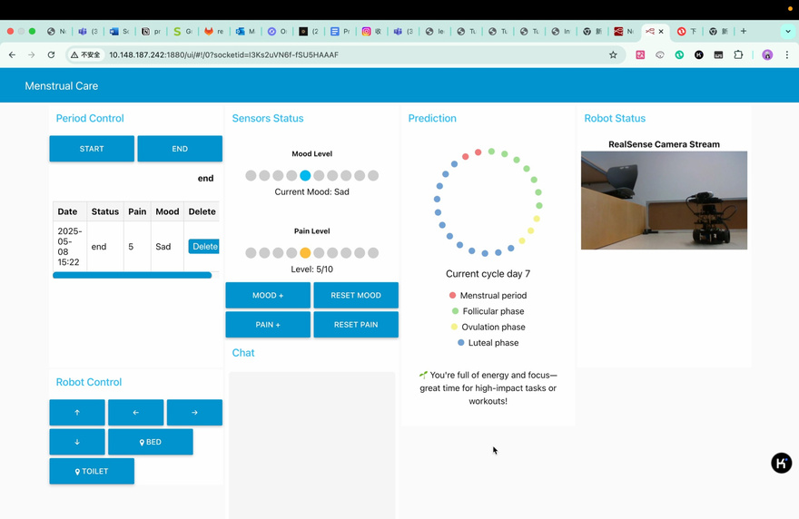
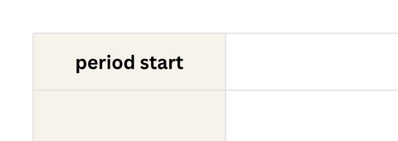
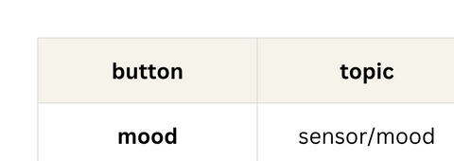
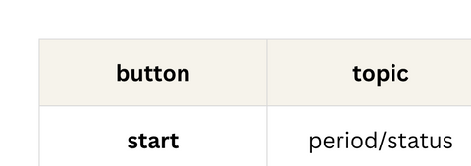
System Architecture
MQTT Broker on RPi
MQTT Client
MQTT Client
implemented by mosquitto
pain/mood levels or
period start/end
depending on the button pressed (i.e. period start, period end, mood, pain) , a different MQTT topic will be published/suscribed to
Notes:
Jing
This is how the data flows. Depending on which button is pressed, a message is sent to a specific MQTT topic. The Raspberry Pi’s broker handles this . Everything from period starts to mood logs follows its own topic so it’s easy to manage and respond to.

Slide 6
Flow Diagram
Data Storage (-/.node-red/data/records.json)
Prediction Output
LED Ring Control
Node-Red Processing System
Phase Text Generation
LED Display Control
Period Button Control
Cycle Prediction Algorithm
Robot Motors
Node-Red DashBoard
TurleBot Movement Control
Position Status Update
Notes:
Jing

Slide 7
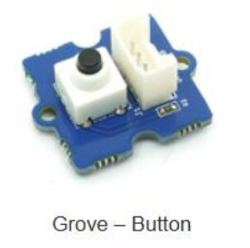
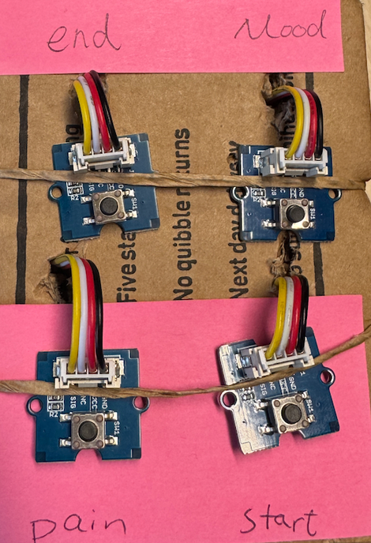
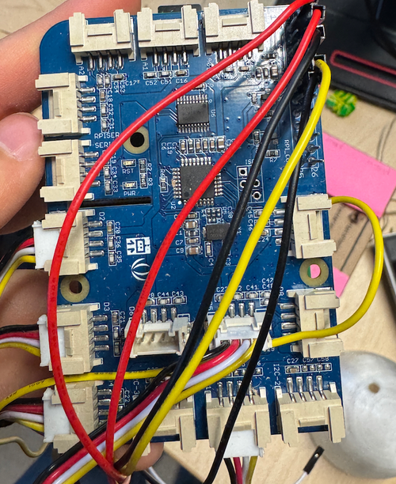
SENSORS
Type of sensor used
Button - we used 4 in total
Connection Ports
D2/3 for period start and end buttons
D4/5 for mood and pain buttons
Functions
Records the start /end date of menstrual period..
..or records the mood/pain levels of user
Notes:
Kardelen
To keep the system simple and easy to use, we used buttons as our main input sensors — four in total.
Two are for logging when your period starts and ends, and the other two are for mood and pain tracking.
They’re connected to the Raspberry Pi using GrovePi+, with ports D2 and D3 for period tracking, and D4 and D5 for mood and pain.

Slide 8
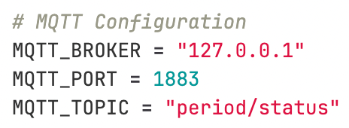
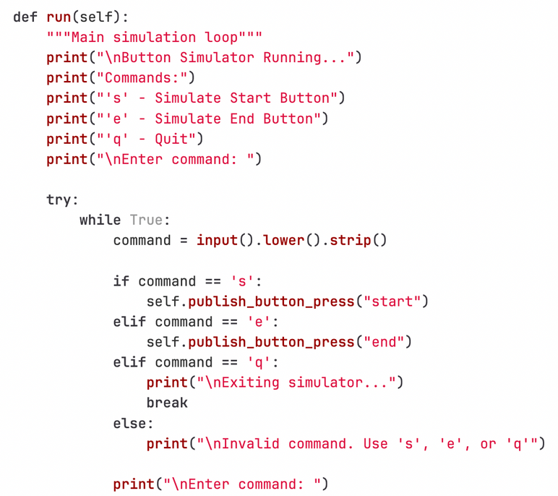
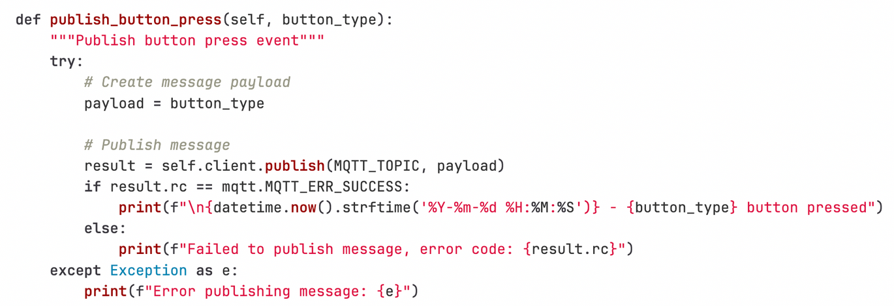
Sensor Implementation
Implementation
Monitors button state through `button_control.py`
sends "start"/"end" message to MQTT topic "period/status" when pressed
The same is done for monitoring pain and mood levels, through s_moodAndPain.py
Notes:
Kardelen
Each button is constantly monitored by a Python script — so for example, if the period start button is pressed, it sends a 'start' message to the period/status topic through MQTT.
Mood and pain work the same way.
So the moment a button is pressed, the message is sent, processed, and passed to the system to update everything else.

Slide 9
SENSOR – CHOICE JUSTIFICATION
Why we chose to use buttons
1
Offers a simple and intuitive physical interface, allowing users to easily log period start/end or mood/pain levels
Addresses a key issue identified in our questionnaire: most tracking apps involve multiple steps unlocking, navigating, and selecting. This makes consistent use more difficult, especially on rough days
One-button operation removes friction from data entry, significantly lowering the barrier to regular, accurate tracking
2
3
Notes:
Kardelen
We chose buttons because they’re physical, quick to use, and don’t require a screen or app.
In our survey, people said they often couldn’t be bothered to go into apps when they weren’t feeling great — which makes sense.
A single button press is way easier, especially when you're in pain or tired.

Slide 10
Sensor Integration
1
Sensor Setup
Sensors were connected via GrovePi+ on the Raspberry Pi, including buttons for period, mood, and pain tracking. Python scripts using the GrovePi library handled data collection.
2
Data Processing & Communication
Node-RED used MQTT to receive sensor data, process it, and visualise it on a dashboard. Data like mood, pain, and period status was stored locally in JSON format.
3
Integration Challenges
LED components had to bypass the GrovePi+ and connect directly to GPIO pins. Limited power from the Raspberry Pi prevented simultaneous use of both the LED strip and ring.
Notes:
Jamie
All the buttons are connected through the GrovePi+ to the RaspberryPi, and we use the GrovePi Python library to read from them.
Data is then passed into Node-RED through MQTT, where it’s processed and saved in JSON format.
One issue we ran into was that GrovePi didn’t support all the LED components, so we had to wire those straight to GPIO pins. Also, power limitations on the Pi meant we couldn’t run everything at the same time — we had to work around that when testing.

Slide 11
ACTUATORS
We used four different actuators:
Mood LED Strip
Pain LED Strip
Cycle Prediction LED Ring
Grove LCD RGB Backlight Display
Notes:
Jamie
We had four actuators:
LED strips for mood and pain levels,
An LED ring to show cycle prediction,
And a backlit LCD display to show the current cycle phase in words.
Each one plays a role in making the system give clear, real-time feedback.

Slide 12
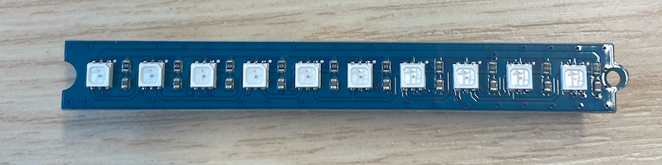
ACTUATOR – LED STRIP
Mood LED Strip
Pain LED Strip
Connection Port: GPIO 18 (PWM)
Number of LEDs: 10
Function:
Visually displays current mood state level
10 LEDs correspond to 10 mood states (Calm, Happy, Excited, Anxious, Sad, Tired, Irritated, Angry, Depressed, Stressed)
Why did we select an LED strip?
Provides intuitive visual feedback
Green represents mood, aligning with psychological concepts of green representing balance and harmony
Connection Port: GPIO 19 (PWM)
Number of LEDs: 10
Function:
Visually displays current pain level
10 LEDs correspond to 10 pain levels
Why did we select an LED strip?
Provides intuitive visual feedback
Red represents pain, aligning with intuitive understanding
Addresses the difficulty users have in recalling and accurately describing pain levels, helping users assess pain more objectively through visual scaling
Notes:
Jamie
Each strip has 10 LEDs. For mood, green lights show how you’re feeling — from calm to stressed.
For pain, red lights show the pain level.
This gives users a visual way to understand and remember how they’re feeling, especially when describing symptoms later.

Slide 13
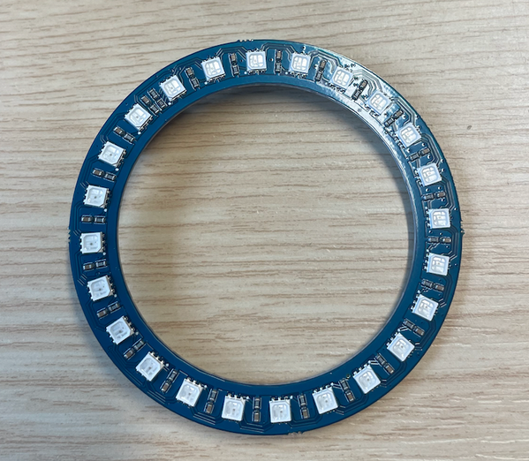
ACTUATOR – LED RING
Cycle Prediction LED Ring
Connection Port: GPIO 21 (PWM)
Model: Grove - RGB LED Ring (20 - WS2813 Mini)
Number of LEDs: 22
Function:
Visually displays menstrual cycle prediction and current cycle phase using different colours to represent the different phases
Color Coding:
Red: Menstrual phase, Green: Follicular phase, Yellow: Ovulation phase, Blue: Luteal phase
Why did we select an LED ring?
Ring design symbolises cyclical nature
Multi-color LEDs intuitively distinguish different cycle phases
Solves the problem of traditional apps requiring opening and navigating to prediction pages; users only need to glance at the device to understand their cycle status
Notes:
Jamie
This ring shows which part of the cycle you’re in — red means menstrual, green for follicular, yellow for ovulation, and blue for luteal. We thought the ring shape worked well for showing something cyclical like this, and the colours are intuitive.

Slide 14
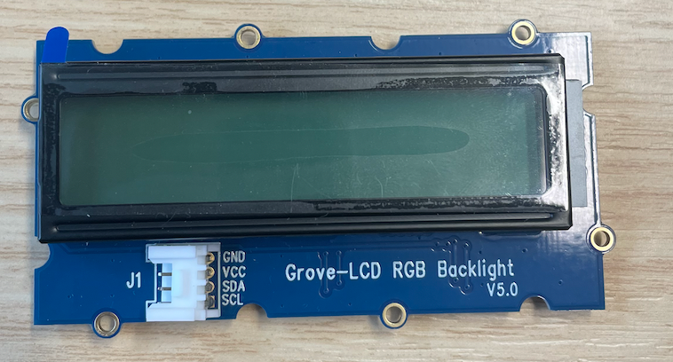
ACTUATOR – BACKLIGHT DISPLAY
Cycle Phase Display
Connection: I2C bus
Display text address: 0x3e
RGB backlight address: 0x30
Function:
Displays the current menstrual cycle phase name
Why did we select a backlight display?
Provides clear textual feedback to communicate the current cycle phase without needing an app
Improves accessibility for users who prefer or rely on text over visual indicators like LEDs
Backlight ensures visibility in different lighting conditions, enhancing usability
I2C connection simplifies wiring and reduces GPIO pin usage
Helps users understand their cycle phases through straightforward, readable labels
Notes:
Jamie
The LCD screen shows the name of the current cycle phase. Some people might find text easier than colour, so this helps with accessibility. It also works well in low light, since it’s backlit.

Slide 15
ACTUATOR IMPLEMENTATION
LED Strips
Cycle Prediction LED Ring
Cycle Phase Display
Controlled through `predict_ring.py`
Displays different colors based on cycle prediction data calculated by Node-RED
Controlled through `backlight.py`
Updates display content and backlight color based on cycle phase
Controlled using the `rpi_ws281x` library
Displays green/red LEDs to indicate mood/pain levels
Notes:
Jamie
Each actuator has its own control script. Node-RED sends out messages that update each component based on the user’s input.

Slide 16
Real-Time Monitoring & Decision Making
The system implements a comprehensive real-time monitoring architecture through multiple layers:
1
Physical Input Layer
2
Data Processing Layer
3
Feedback Layer
4
Multi-Sensor Decision Making
Notes:
Jamie
Our system is built for real-time interaction. It has four main parts:
Buttons for input,
The Pi and Node-RED for processing,
LEDs and screen for feedback,
And decision-making based on combined input and prediction logic.

Slide 17
Real-Time Monitoring & Decision Making
Physical Input Layer:
Data Processing Layer:
Period tracking through start/end buttons (button_control.py)
Mood levels through 10-state button input (moodAndpain.py)
Pain levels through 10-state button input (moodAndpain.py)
MQTT-based real-time message broker for instant data transmission
Node-RED flows for immediate data processing and state management
Synchronous LED feedback for user input confirmation
Notes:
Jamie
When a user presses a button, that input is instantly sent as a message through MQTT. Node-RED picks it up, processes the data, and updates the LEDs or screen. This means the feedback happens right away, so it feels responsive and reliable.

Slide 18
Idle
Real-Time Monitoring & Decision Making
Processing
Feedback layer
Provides real-time visual confirmation of inputs using MQTT-driven state machine logic, ensuring fast and reliable user feedback.
Synchronises outputs across hardware (LEDs, LCD) and the web dashboard (Node-RED) for consistent multi-channel display.
Coordinates input processing and display updates through a structured state machine, maintaining platform-wide state accuracy.
Period tracking
Mood/pain tracking
Prediction calculation
Update mood LED
Feedback
Hardware Feedback
Web Feedback
Show LED/LCD feedback
Update Node-RED dashboard
Notes:
Jamie
The feedback is split across hardware and the web interface. So when you press a button, the LED lights and LCD update, and the Node-RED dashboard does too. This way, everything stays in sync — no matter where the user is looking.

Slide 19
Real-Time Monitoring & Decision Making
Multi-Sensor Decision Making:
1. Period Phase Determination:
Uses period start/end button inputs
Determines cycle phase (Menstrual, Follicular, Ovulation, Luteal)
Updates LED ring and LCD display accordingly
3. Predictive System:
Uses historical period data
Calculates cycle predictions
Updates 20-LED ring display with phase predictions
Colour codes different phases for intuitive understanding
2. User State Monitoring:
Combines mood and pain inputs
Provides visual feedback through multiple LED indicators
Synchronises state across all display components
Notes:
Jamie
We use the period start/end buttons to figure out what phase the user is in. That updates the LED ring and the screen. Mood and pain levels update the strips, and we also do basic predictions using stored history to show what phase is likely coming up next.

Slide 20
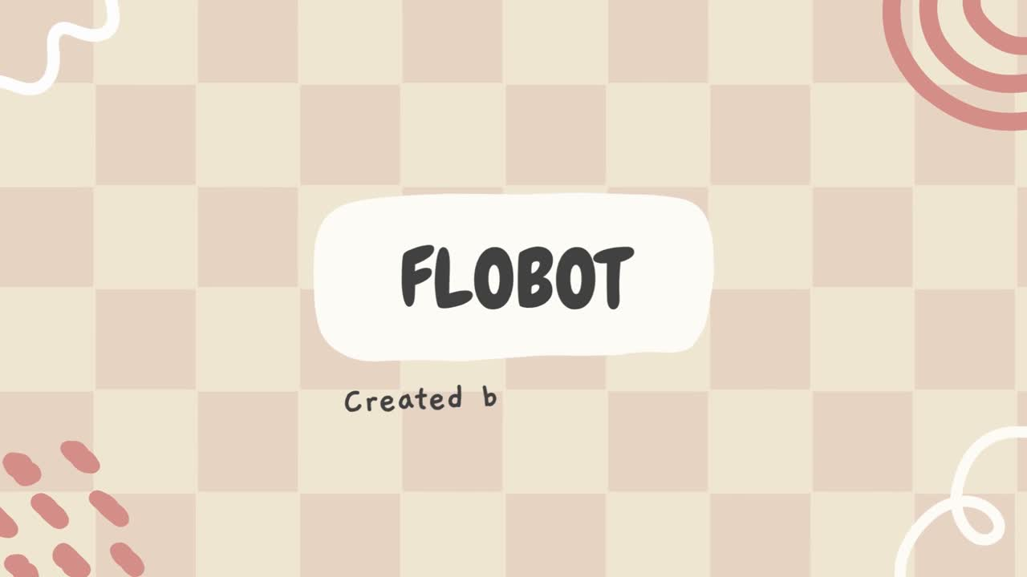
Demonstration Video
Notes:
Jing
Here’s a short video showing FloBot in action.

Slide 21
Challenges Faced
Limited Hardware Access
Integration & Compatibility Challenges
Database & Prediction Constraints
Updating Node-RED and supporting libraries on the Raspberry Pi was difficult, limiting some feature implementations. While we explored integrating a custom Node.js + Express + SQLite platform, deployment complexity led us to use Node-RED's built-in Dashboard for a more stable and maintainable interface.
We initially considered a cloud database to support larger datasets and enable ML-based predictions, but compatibility issues and setup complexity made this unfeasible. We used a local database with simple averaging for predictions, and UI limitations restricted visible data to the last 10 entries.
Hardware was only available in the lab, which had restricted opening hours, especially during the Easter break when team members were off campus. This made it harder and slower to test hardware-dependent features.
Notes:
Jing

Slide 22
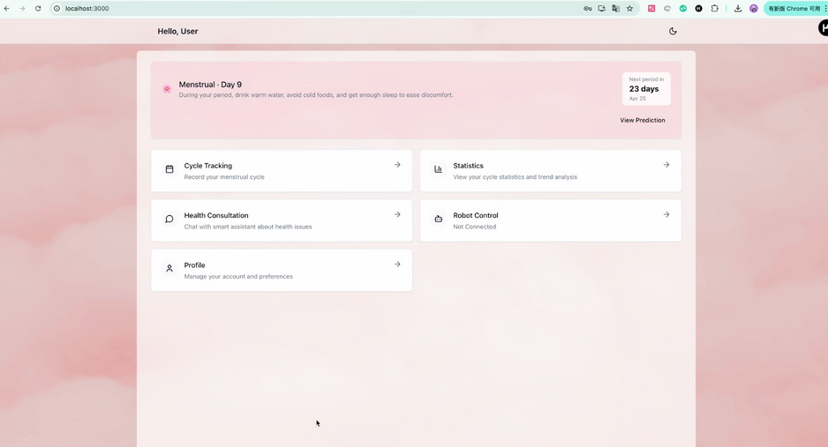
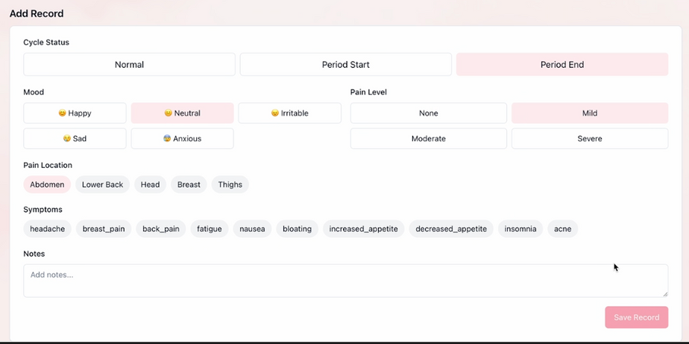
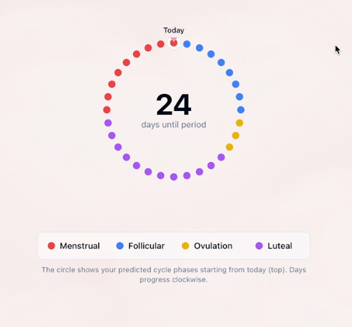
Challenges Faced
Limited Hardware Access
we initially tried to create our user interface using devbox, however it required a subscription
the code for the website was also too complicated to integrate with our hardware so we instead created our UI using node red
Notes:
Jing
We also tried building a front-end using Devbox, but that platform needed a subscription. On top of that, the integration with our Pi-based system didn’t work cleanly. So we kept everything in Node-RED, which turned out to be a solid choice.

Slide 23
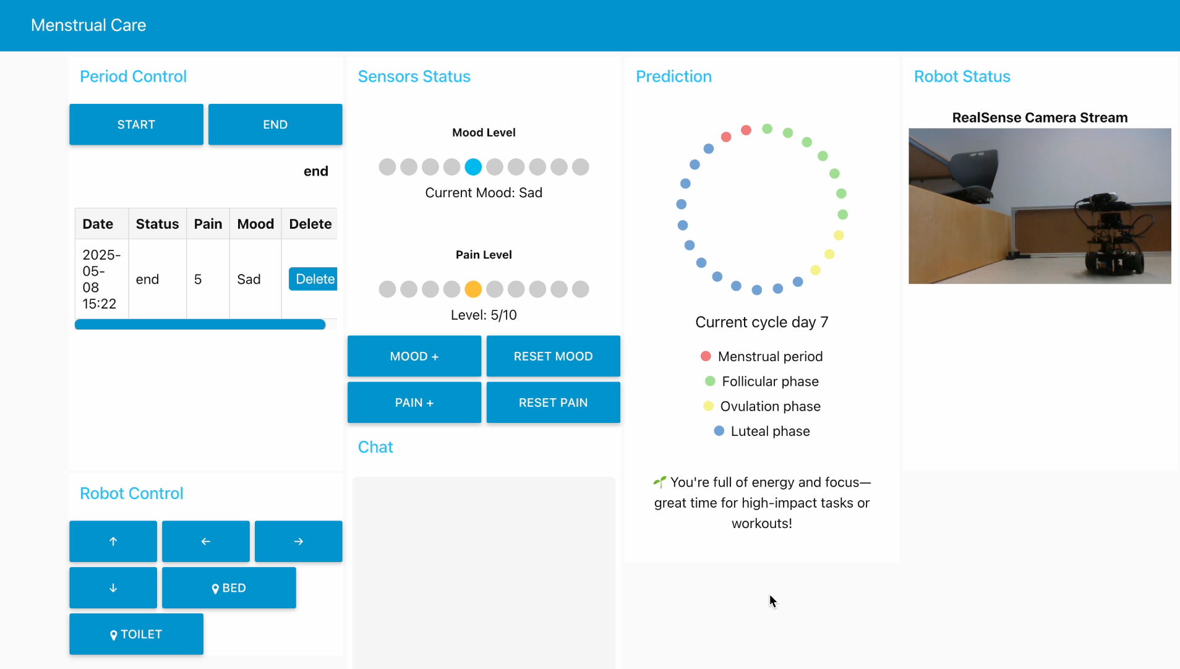
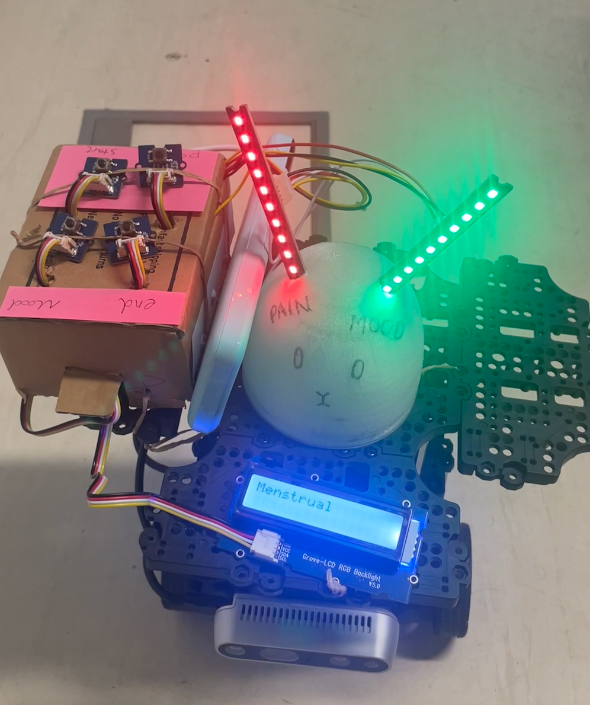
﻿RESULT
Flobot
User Interface
3d printed bunny cover
Notes:
Jing
Here’s our result. On the left is FloBot — with a 3D-printed bunny head to make it more approachable.
On the right is our dashboard.

Slide 24
Key Learnings
User-Centered Development & System Thinking
Sensor Integration & Communication Design
Hardware Constraints & Environmental Awareness
Working with multiple inputs required us to calibrate sensors, handle noisy data, and standardise formats to ensure smooth communication across components. Real-time coordination using MQTT taught us how to manage asynchronous data and keep all system parts in sync.
Limited hardware access and real-world constraints like sensor placement and terrain helped us appreciate the physical challenges of robotics and the importance of testing in realistic conditions. Overall, we shifted from a bug-fixing mindset to proactive system design, emphasising reliability, clarity, and user experience.
Throughout this project, we developed both technical and system-level thinking skills. We learned to design with the user in mind, focusing on intuitive interaction and meaningful feedback rather than just technical implementation.
Notes:
Jing
This project taught us to think more like designers. We weren’t just coding or wiring things up — we had to think about how people would actually use the system, and how to make it work in a way that felt easy and useful.
We also learned how to manage multiple inputs at once — dealing with noisy data, calibrating sensors, and making sure messages went through properly with MQTT. It showed us how important timing and synchronisation are in robotics.

Slide 25
Future Improvements
Voice Interaction Integration
Add voice input for natural symptom logging
Automate data capture from speech to improve ease-of-use
Additional Functions
Add heating pad module for comfort
Add internal storage for menstrual products or supplies
Implement one-touch emergency contact feature
Create a companion smart wristband to monitor vitals and provide reminders
Notes:
Jing
For future versions, we’d love to add voice input to make symptom logging even easier. Other ideas include a built-in heating pad, internal storage for supplies, a smart wristband, or even a one-touch emergency button.

Slide 26
Conclusion
FloBot integrates real-time tracking, intuitive interaction, and predictive insights to support menstrual health in a meaningful way. By combining multiple sensors with a robust feedback system, we built a user-focused solution that’s both functional and accessible.
This project strengthened our skills in system design, user-centered thinking, and hardware-software integration; highlighting how robotics can address everyday health challenges.
Notes:
Kardelen
In the end, FloBot brings together simple interaction, real-time updates, and predictive logic to support menstrual health. We’re proud of how far we took this idea, and how much we learned about robotics, sensors, and user-focused design along the way.

Slide 27
THANK YOU
Presented By : Kardelen Yagiz, Jing Xu and
Jamie Holt
Notes:
Kardelen
Thanks for listening!

